Slide 1
CIT 550 Group Project Proposal

Slide 2
Motivation
Peer-to-peer (P2P) accommodations have scaled up in the wave of enthusiasm for innovative internet technologies, which challenge the conventional hotel industry.
Airbnb has risen as a dominant player of P2P accommodation platforms
To better assist hosts, Airbnb should provide dynamic analysis of comparison between Airbnb hosts and traditional hotel competitors in the same neighborhood or even larger area.
Our team proposes to establish a website which offers update-to-date analysis, which allows hosts to understand their product/service positioning, identify niche market, and optimize pricing strategies.

Slide 3
Databases
http://insideairbnb.com/
We select the most visited city in California
Los Angeles (e.g., listings table with 42452 records, calendar table with 1048576 records. It is expected to have 300-500 hotels)

Slide 4
Database Listings
id | Name (e.g., Brand new private studio) | Description (text) | Neighborhood overview (text) | Picture_url
Host_id | Host_url | Host_name | Host_location(e.g.,Chino, CA) | Host_about(text)
Host_response_time | Host_response_rate | Host_acceptance rate | Host_is_superhost | Host_neighborhood (e.g., San Pedro, many null)
Host_listings_count | Host_listings_count | Host_total_listings_count | Host_verifications (e..g., phone, email) | Host_has_profile_photo (y/n)
Host_identity_vertification (y/n) | Neighborhood (e.g., many null) | Latitude | longitude | Property_type
Room_type | Accommodates (num of guests) | Bathroom num | Bed num | Bedrooms num
amenities | price | Minimum_nights | Maximum_nights | Availability_30

Slide 5
Database Listings (Conti.)
Availability_60 | Availablity_90 | Availablity_365 | Number_of_reviews
review_scores_rating | review_scores_accuracy | review_scores_cleanliness | review_scores_checkin | review_scores_communication
review_scores_location | review_scores_value | license | instance_bookable(y/n) | calculated_host_listings_count
calculated_host_listings_count_entire_homes | calculated_host_listings_count_private_rooms | calculated_host_listings_count_shared_rooms | reviews_per_month

Slide 6
Scraping data from hotels.com (or any other hotel booking websites)
Latitude | longitude
Overall review score | Review_cleanliness score
review_staff&service score | Review_amentities score
Review_ property condition & facilities score | Review_eco_friendliness score
Price

Slide 7
Research Question #1: Relationship between property type/size and price
Attributes in table listings: property_type, room_type, accommodations(number of guests), bathroom number, bed number, bedroom number, amenities, price
Website visualization: bar chart, etc.

Slide 8
Research question #2:Relationship between service and price
Attributes in table listings: host response rate, host response time, host acceptance rate, license, superhost, instance_booktable price
Website visualization: bar chart, etc.

Slide 9
Research question #3:Relationship between review ratings and price
Attributes in table listings: overall review ratings, review ratings in different categories, price
Website visualization: bar chart, etc.

Slide 10
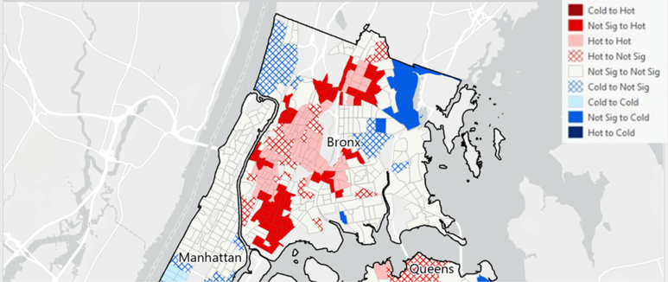
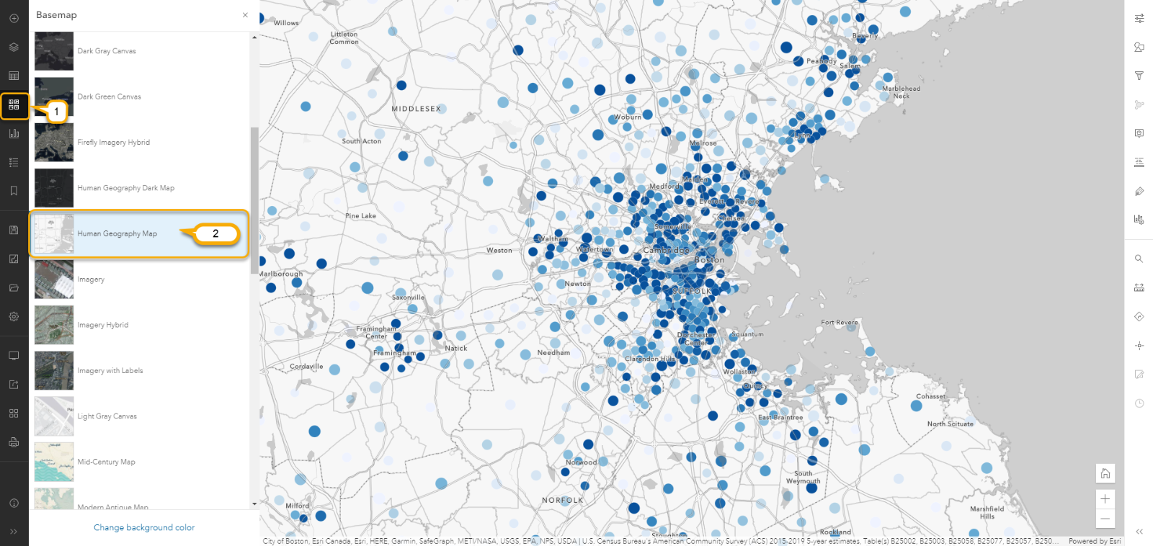
Research question #4: Geographic distribution of Airbnb and hotels
Table of listings: Latitude and longitude
Scraped hotel data: Latitude and longitude
Software for analysis: React map()/GeoDa (e.g. hotspot analysis)

Slide 11
Research question #5: Distribution of Airbnb and hotels with different price range
Table of listings: Latitude and longitude
Scraped hotel data: Latitude and longitude
Software for analysis: GeoDa (e.g. hotspot analysis)

Slide 12
Research question #6: Top hosts in different regions
Table of listings: Host name, property type, private room, number of listings, host response rate, host response time, host acceptance rate, overall reviews, review ratings in different categories

Slide 13
Distribution of work
Work | Lead | Assistant
Oversee the technical framework of the website | Zhongyin
Frontend | Zhongyin | Xiaofei (website aesthetic design) 多特(assist Zhongyin in data visualization part)
Gitup setup, version control, etc. | Xiaofei
Backend(server) | Xiaofei
Scraping data, data cleaning for map part, data visualization (including charts and maps), as well as design ppt and prepare video for final demonstration | 多特
Backend(database), including data cleaning for database | Rebecca
Documentation | Rebecca
Design website content and coordinator (meetings, submit reports, etc.) | Rebecca

Slide 14
Timeline
Milestone | Description | Week Due | Personnel & Responsibility | Internal deddline
M​ilestone 0 | Project Group (done) | 4 | Rebecca: fill the form on team formation; write project proposal; finish cleaning database from insideairbnb Xiaofei: setup Github Duote: learn scraping data | 4
M​ilestone 1 | Project Proposal | 6 | Duote: finish scraping data Rebecca: database population and design SQL queries, as well as write project outline; Xiaofei: finish website design Zhongyin: setup the basic structure of website | 6
M​ilestone 2 | Project Outline | 9 | Zhongyin: setup the initial version of website Xiaofei: setup basic structure of server Duote: create maps, charts, etc Rebecca: finalize database queries | 9
M​ilestone 3 | Database Population, SQL Queries | 11 | Xiaofei: merge queries into server part Zhongyin & Xiaofei: connect frontend and backend, and test Rebecca: optimize queries | 11

Slide 15
Timeline
Milestone | Description | Week Due | Personnel & Responsibility | Internal deadline
M​ilestone 4 | Mentor Meeting, API Spec | 13 | Rebecca: communicate and prepare API Spec (need some information from Zhongyi and Xiaofei) for the meeting with mentor; optimize queries Zhongyin & Xiaofei: connect frontend and backend, and test | 13
M​ilestone 5 | Final Report, Application Code, Application Demo Video | 14 | Rebecca: finish final report Duote: ppt, demo video, etc. | 14
Final | Final Demo | 15 | Teamwork | 15

